Slide 1
Nervous System
JAMES VALLEY VOCATIONAL TECHNICAL CENTER

Slide 2
Notes:
Tell the person next to you everything you know about the brain/nervous system

Slide 3
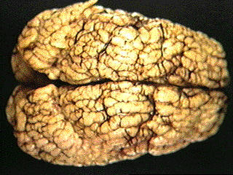
Function of the Nervous System
Control of all bodily functions (voluntary and involuntary)
Electrical impulses are sent along nerves
Two systems – central nervous system and peripheral nervous system

Slide 4
Divisions of Nervous System
Central Nervous System (CNS)
consists of brain and spinal cord
Peripheral Nervous System (PNS)
any nerves outside the brain and spinal cord
sensory and motor divisions.

Slide 5
Divisions of Nervous System
CNS

Slide 6
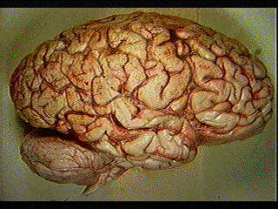
Central Nervous System
PARTS OF THE CNS

Slide 7
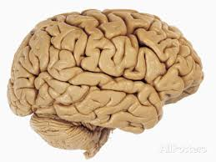
Cerebrum (Cerebral Cortex)

Slide 8
Cerebrum (Cerebral Cortex)

Slide 9
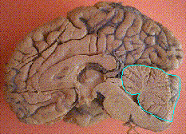
Cerebellum

Slide 10
Midbrain

Slide 11
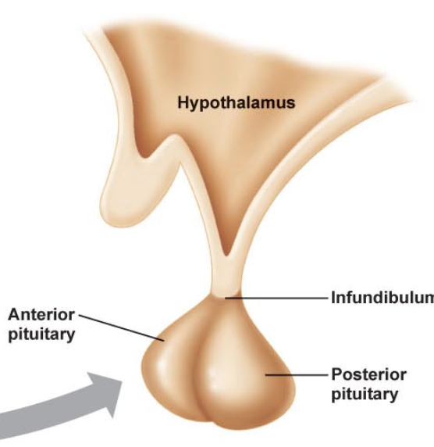
Pons
Hypothalamus

Slide 12
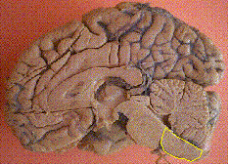
Medulla Oblongata
WARNING: IMAGE NEXT SLIDE

Slide 13
Spinal Cord

Slide 14
Cerebrum (Cerebral Cortex)
Responsible for:
reasoning, thought, memory, speaking, sensation, sight, hearing, voluntary body movement
Why do you think there are so many
convolutions (folds)?

Slide 15
Cerebellum
Responsible for:
coordination of muscles, balance and posture

Slide 16

Midbrain
Responsible for:
sending impulses between different parts of the brain
certain eye reflexes

Slide 17
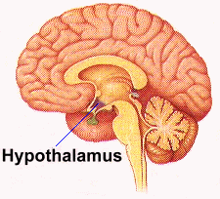
Pons
Hypothalamus
Responsible for:
Things we don’t consciously control.
Body temperature, water balance and emotional responses

Slide 18
Medulla Oblongata
Connects to the spinal cord
Responsible for:
Things we don’t consciously control
regulating heart rate and force, rate and depth of respirations.

Slide 19
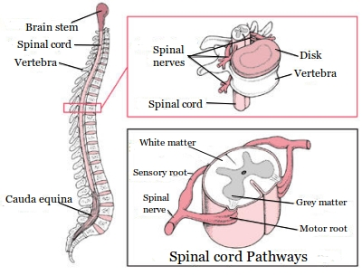
Spinal Cord
Responsible for reflex actions
Carries messages
Protected by vertebrae

Slide 20
Grey and White Matter

Slide 21
Grey and White Matter
Grey matter: Cell bodies, dendrites and axon terminals of nerves
White matter: the myelin covered axons of nerves

Slide 22
Grey and White Matter

Slide 23
Central Nervous System
Protected by:
Meninges: coverings of the brain. Protect the brain by having fluid filled spaces. Three layers.
Cerebrospinal fluid (CSF): acts a shock absorber, cushioning any blows.
Bones: Cranium and vertebrae

Slide 24
Divisions of the Nervous System
PNS

Slide 25
Peripheral Nervous System
PARTS OF THE PNS

Slide 26
Peripheral Nervous System:
All nerves outside of the CNS
eg: Toes, feet, legs, torso, chest, finger, hands, arms…….etc, etc
Connect to the spinal cord

Slide 27
Peripheral Nervous System:
Two division of PNS:
Sensory Pathway
Motor Pathway

Slide 28
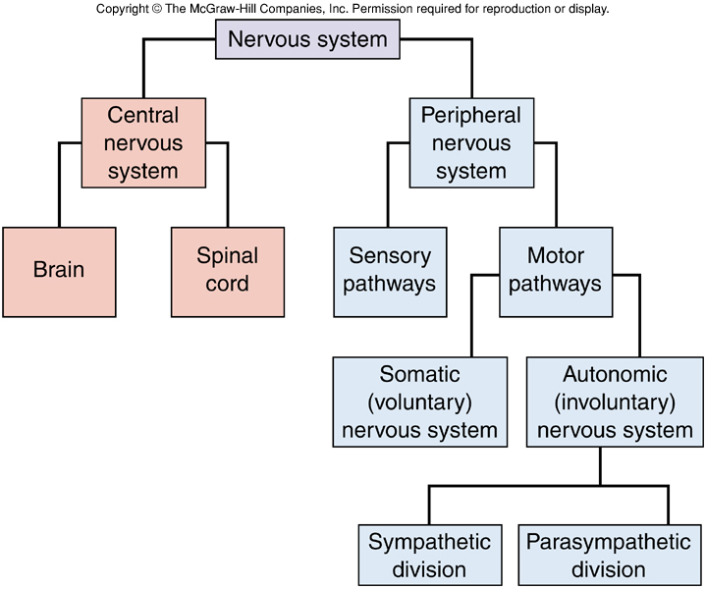
Peripheral Nervous System
Made of all nerves outside the brain and spinal cord
These nerves carry the messages from or to the CNS
Sensory neurons
Motor neurons

Slide 29
Peripheral Nervous System: Sensory and Motor divisions
Sensory Pathway
Impulses to the CNS from skin, joints, muscles and internal organs
Things you can SENSE

Slide 30
Peripheral Nervous System: Sensory and Motor divisions
Motor Pathway
Impulses from the CNS

Slide 31
Peripheral Nervous System: Sensory and Motor divisions
Motor Pathway
Divided into 2
Somatic division:
Autonomic division:

Slide 32
Peripheral Nervous System: Sensory and Motor divisions
Motor Pathway
Somatic division: impulses from the CNS to muscles we control consciously i.e. your hand and finger to write
Autonomic division: carries impulse from the CNS to muscles we can’t consciously control

Slide 33
Peripheral Nervous System
Made of all nerves outside the brain and spinal cord
These nerves carry the messages from or to the CNS
Sensory neurons
Motor neurons

Slide 34
Peripheral Nervous System
Made of all nerves outside the brain and spinal cord
These nerves carry the messages from or to the CNS
Sensory neurons
Motor neurons

Slide 35
Peripheral Nervous System:
The autonomic division: things we don’t consciously control.
We subconsciously control them.
Divides into 2 – sympathetic and parasympathetic division
Sympathetic = fight or flight
Parasympathetic = rest and digest

Slide 36
Peripheral Nervous System:
Sympathetic = fight or flight
Increase heart rate, dilation of bronchioles, contracts rectum
Parasympathetic = rest and digest
Stimulate saliva, relaxes rectum

Slide 37
PNS nervous system https://www.youtube.com/watch?v=zeo19WVQ47w After watching complete booklet page: 7-8

Slide 38
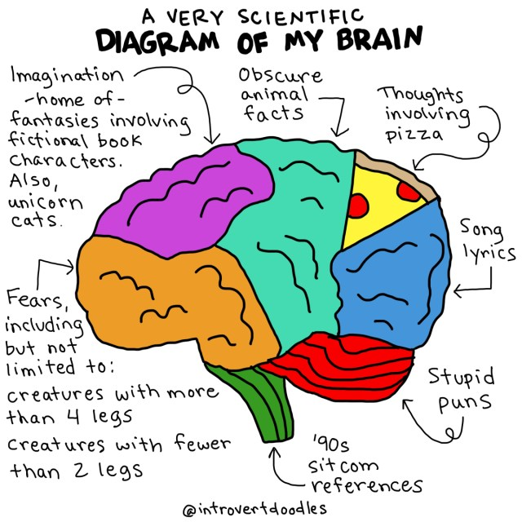
CARD MATCHING
Notes:
In groups of 3 you have all the parts of the nervous system and there definitions. Create a flow diagram on your desk with these cards

Slide 39
QUIZ: 1. The CNS is protected by? 2. Which part of the brain is responsible for -thought and memory? - heart rate? 3. PNS divides into the ….....and ......... 4. Which of the above sends messages to the CNS? 5. Which part of the PNS do we consciously control? Give an example

